Slide 1
SJSU CS 46A Introduction to Programming
When you come in
Open Canvas
Download Lesson03_student.zip
Unzip it
Join our class on iClicker after started

Slide 2
Homework01
Due time: 10 pm, Saturday, Sep 03
Grace time: 10 am, Sunday, Sep 04
Individual assignment
Help from others is OK
Do not work together
Do not share your completed program with others
Follow instructions
Lab Rubrics

Slide 3
SJSU CS 46A Introduction to Programming
2.3 Calling Methods
2.4 Constructing Objects
Notes:
Sections 2.3 – 2.4

Slide 4
How to Use Objects?
Create an object
Call (activate) methods on the object
Picture pic = new Picture("redwood.png");
pic.draw();
pic.grow(25, -10);
pic.translate(20, -10);
Notes:
How vs Why

Slide 5
Class Day
Lesson03Examples
Notes:
Open class Day
Look at Documentation (Ctrl+J)

Slide 6
Constructor Declaration
Parameter (argument) list
public Day()
Construct a Day object representing today’s date.
public Day(int aYear, int aMonth,
int aDayOfMonth)
Construct a Day object with a given year, month, and day.
Notes:
San Jose time and Codecheck time

Slide 7
Constructing Objects
// public Day()
Day aDay = new Day();
Notes:
How to get today’s date?

Slide 8
iClicker Question #1
public static void main(String[] args)
{
Day aDay;
Day aDay = new Day();
System.out.println(aDay.toString());
}
Which of the following is correct?
A. The output is “2022-09-01” when running today.
B. The output is “2022-09-02” when running tomorrow.
C. Both A and B are correct.
D. It does not compile.

Slide 9
Do not Declare a Variable Twice
public static void main(String[] args)
{
Day aDay;
Day aDay = new Day();
System.out.println(aDay.toString());
}
Which of the following is correct?
A. The output is “2022-09-01” when running today.
B. The output is “2022-09-02” when running tomorrow.
C. Both A and B are correct.
D. It does not compile.
Notes:
Prog DayApp

Slide 10
Another Constructor
// public Day(int aYear, int aMonth,
// int aDayOfMonth)
Day hw02DueDay = new Day(2022, 9, 10);
Notes:
How to get today’s date?

Slide 11
Using Variables to Provide Parameters
int year = 2022, month = 9, day = 11;
// public Day(int aYear, int aMonth,
// int aDayOfMonth)
Day hw02GraceDay = new Day(year, month, day);
Formal Parameters
Actual Parameters

Slide 12
Methods of Class Day
public String toString()
public int getDayOfMonth()
public int getMonth()
public int getYear()
public int daysFrom(Day another)
public void addDays(int numberOfDays)

Slide 13
Method Declaration
public String toString()
Access specifier
public/private
Return type
Method name
Parameter (argument) list

Slide 14
Calling Method on Objects
Day aDay = new Day();
// public String toString()
System.out.println(aDay.toString());
// Output: 2022-09-01
// Auto-Completion: Ctrl+Space
System.out.println(hw02DueDay.toString());
// Output: 2022-09-10

Slide 15
Calling Method on Objects
int year = 2022, month = 9, day = 11;
Day hw02GraceDay = new Day(year, month, day);
// Store the string using a variable
String str = hw02GraceDay.toString();
System.out.println(str);
// Output: 2022-09-11

Slide 16
public int getDayOfMonth()
public int getMonth()
public int getYear()

Slide 17
Method daysFrom()
// Returns the number of days between
// this day and another day.
public int daysFrom(Day another)
Access specifier?
public
Return type?
int
the return value can be negative
Parameters?
Day another
Will it change this Day object?
No

Slide 18
Calling Method daysFrom()
Day aDay = new Day(); // 2022-09-01
Day hw02DueDay = new Day(2022, 9, 10);
int days = aDay.daysFrom(hw02DueDay);
// days: aDay – hw02DueDay
// -9
System.out.println(hw02DueDay.daysFrom(aDay));
// days: 9
this day
another day

Slide 19
Method addDays()
// Changes this date to a date that is a
// certain number of days away.
public void addDays(int numberOfDays)
Access specifier?
public
Return type?
void: does not return anything
Parameters?
int numberOfDays
Can it be negative?
Will it change the object?
Yes

Slide 20
Calling Method addDays()
Day aDay = new Day();
System.out.println(aDay.toString());
// 2022-09-01
// Change it to 4 days later
aDay.addDays(4);
System.out.println(aDay.toString());
// 2022-09-05

Slide 21


Slide 22
Calling Method addDays()
Day aDay = new Day();
aDay.addDays(4);
System.out.println(aDay.toString());
// 2022-09-05
// Change it to 6 days earlier
aDay.addDays(-6);
System.out.println(aDay.toString());
// 2022-08-30
Notes:
Chinese new year

Slide 23
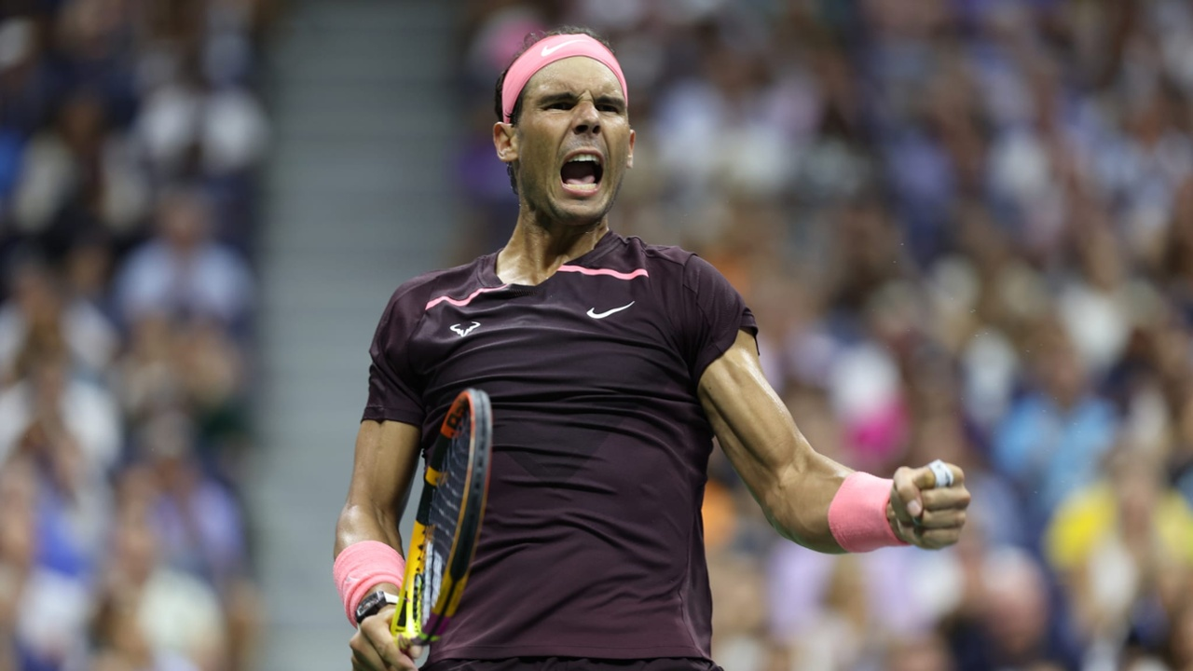
Rafael Nadal earns grand victory
in 2022 US Open return on 08/30

Slide 24
iClicker Question #2
public static void main(String[] args)
{
Day myDay = new Day();
Day.addDays(7);
System.out.println(myDay.toString());
}
Which of the following is correct?
A. The output is “2022-09-08” when running today.
B. The output is “2022-09-09” when running tomorrow.
C. Both A and B are correct.
D. It does not compile.

Slide 25
Do Not Call Methods on a Class
public static void main(String[] args)
{
Day myDay = new Day();
Day.addDays(7);
System.out.println(myDay.toString());
}
Which of the following is correct?
A. The output is “2022-09-08” when running today.
B. The output is “2022-09-09” when running tomorrow.
C. Both A and B are correct.
D. It does not compile.

Slide 26
Calling Methods on Objects
public static void main(String[] args)
{
Day myDay = new Day();
myDay.addDays(7);
System.out.println(myDay.toString());
}
Select all from the following that are correct.
A. The output is “2022-09-08” when running today.
B. The output is “2022-09-09” when running tomorrow.
C. Both A and B are correct.
D. It does not compile.

Slide 27
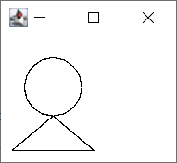
Drawing a Circle on a Triangle
Circle
radius: 25
position: (20, 20)
Triangle
Isosceles
height: 30
base: 70

Slide 28
Class Ellipse
// (x, y): the upper-left corner of the bounding box
// width and height: the size of the bounding box
public Ellipse(double x, double y,
double width, double height)
An ellipse is a circle when width is the same as height.

Slide 29
Class Line
// (x1, y1): the starting point
// (x2, y2): the ending point
public Line(double x1, double y1, double x2, double y2)
A triangle has three lines,
and we need the positions of three points.

Slide 30
Circle: Ellipse
radius: 25
position: (20, 20)
Triangle: three lines
Isosceles
height: 30
base: 70
(45, 20)
(20, 20)
25
50
(45, 70)
A
30
B
35
C
(10, 100)
(80, 100)

Slide 31
Drawing the Circle
// (x, y): the upper-left corner of the bounding box
// width and height: the size of the bounding box
public Ellipse(double x, double y,
double width, double height)
// (x, y) coordinates: (20, 20)
// width and height: 50
Ellipse circle = new Ellipse(20, 20, 50, 50);
circle.draw();

Slide 32
Drawing the Triangle
// (x1, y1): the starting point
// (x2, y2): the ending point
public Line(double x1, double y1, double x2, double y2)
Line lineAB = new Line(45, 70, 10, 100);
Line lineAC = new Line(45, 70, 80, 100);
Line lineBC = new Line(10, 100, 80, 100);
lineAB.draw();
lineAC.draw();
lineBC.draw();

Slide 33
Class CircleOnTriangle
BlueJ Project Lesson03Examples

Slide 34
iClicker Question #3
public static void main(String[] args)
{
Ellipse circle = new Ellipse(50, 50, 100);
circle.draw();
}
The above main() method will draw a circle of diameter 100 at location (50, 50).
A. True
B. False

Slide 35
Number of Parameters
public static void main(String[] args)
{
// Ellipse circle = new Ellipse(50, 50, 100);
Ellipse circle = new Ellipse(50, 50, 100, 100);
circle.draw();
}

Slide 36
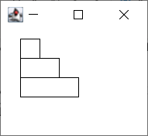
Par03 Problem B
Stair: Three rectangles
Location: (0, 0)
Width: 20, 40, 60
Height: 20

Slide 37
Class Rectangle
One constructor
public Rectangle(double x, double y,
double width, double height)
One method draw()
public void draw()

Slide 38
Par03
The zip file of the lesson contains two BleuJ projects for Par03.
Follow the specified steps to complete them.
Par03_A: codecheck link
http://www.codecheck.it/files/210208042934klkoza3vjji99wfst9topjn
Par03_B: Codecheck link
http://www.codecheck.it/files/2006161612bt3hvyujwcu5e6q8o0zxd22yi

Slide 39
Par02 Solutions
Breakout Rooms
My Office Hours
8 – 9 pm

